Slide 1

Year 4 | Week 6 | Day 1
£8.94 £8.49

Slide 2

Year 4 | Week 6 | Day 2
25
20
15
Number of children
10
5
0
Favourite colour

Slide 3

Year 4 | Week 6 | Day 3
50
40
30
Number of children
20
10
0
Favourite colour

Slide 4





Year 4 | Week 6 | Day 4
Sport played | Number of children
Football
Rugby
Netball

Slide 5

Year 4 | Week 6 | Day 5
Sport played | Number of children
Football
Rugby
Netball

Slide 6

Year 4 | Week 7 | Day 1
Day | Number of visitors
Saturday | 8,479
Sunday | 6,292

Slide 7

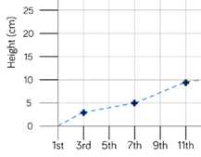
Year 4 | Week 7 | Day 2
Height of plant
Date
Favourite chocolate | Number of children
Milk chocolate
White chocolate

Slide 8
Year 4 | Week 7 | Day 3
Height of plant
Date

Slide 9

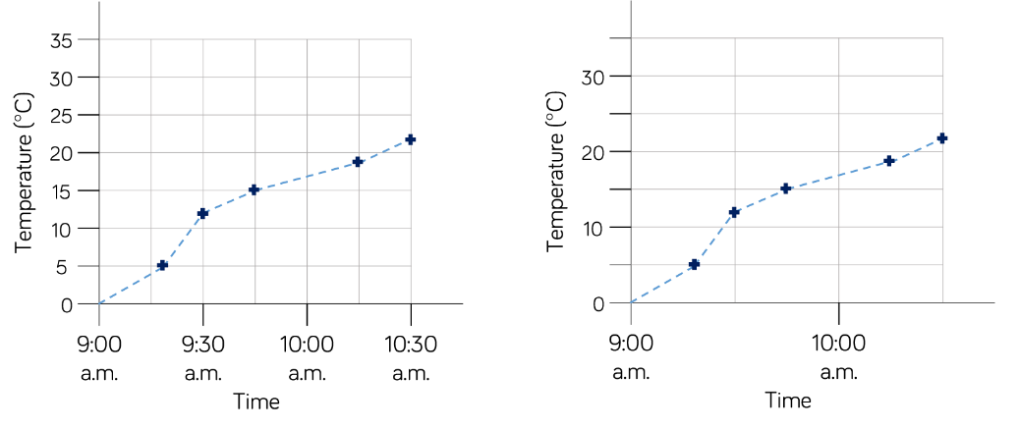
Year 4 | Week 7 | Day 4

Slide 10
Year 4 | Week 7 | Day 5

